Slide 1
State in your reactive system
Notes:
In this session I am going to talk about something we are already familiar. Those who knows it will be refresher session and for others it will be new learning.
In this session, we will talk about how our design evolve as we progress with the session. We initially start with basic design but as we progress we will identity problems and how are evolving it to fix those problems.

Slide 2
Reactive Systems Vs Micro Services
Reactive Systems (2014)
Responsive
Elastic
Resilient
Message Driven
Micro Services (2011)
structures an application as a loosely coupled set of services
Each service is owned by a team, which has sole responsibility for making changes.
Other Definitions,
Independently deployable
Loose coupling
Fault tolerant
flexible
Notes:
Reactive Systems (characteristics => responsive, elastic, resilient, message driven). If we are not responsive then there is no point talking about rest 3.
Reactive systems => reactive coding in a non distributed way. What can we apply from micro service and reactive systems to make microservices more reactive.
Ref:
https://microservices.io/patterns/decomposition/service-per-team.html
https://martinfowler.com/articles/microservices.html
https://www.reactivemanifesto.org/

Slide 3

Impatient Customer
1. Place Order
Warehouse service
Desk Service
Exchange Service
2. Place Shipping Order
2. Handle order
2. Place exchange Order
Notes:
Reliance store example

Slide 4
Impatient Customer
4. New Order Delivered
6. Exchange Item picked up
Warehouse service
Desk Service
Exchange Service
3. Order Confirmed for shipping
5. Exchange item Pickup confirmed
Notes:
Reliance store example

Slide 5
Synchronous communication
//warehouse controller with endpoint
@PostMapping(“/warehouse”)
fun prepare(@RequestBody orders:Orders):Orders {
return warehouseService.prepareOrders(orders)
}
//desk service calling warehouse endpoint
fun handleOrders(orders:Orders): Orders {
val savedOrders = deskRepository.save(orders)
Var warehouseResponse:Any? = null
Try{
warehouseResponse = restTemplate.postForObject(url, orders, Orders::class)
} catch(exception:Exception) {
//do something
}
// REST OF THE CODE
}
Warehouse service
Data returned
Request
Desk Service
Notes:
Desk service will call and wait for the warehouse service to finish. This might work but it is a blocking code. It means I don’t have thread free for other request handling. It is fine for low traffic but for high demand, for most architecture this will not work.

Slide 6
Frontend
REST
WEB
Warehouse service
Desk Service
Exchange Service
WEB
REST
REST
WEB
Notes:
Overall, easily with spring component, but system has lot of blocking code and is not a responsive system.

Slide 7
Blocking
Responsive
Elastic
Resilient
Message Driven
Notes:
It is blocking, If it is not responsive there is no need to check for the rest of the item.

Slide 8
Asynchronous communication
Warehouse service
//warehouse controller with endpoint
@PostMapping(“/warehouse”)
fun prepare(@RequestBody orders:Orders):Mono<Orders> {
return warehouseService.prepareOrders(orders)
}
//desk service calling warehouse endpoint
fun handleOrder(order:Order){
Return webClient.method(POST)
.uri(warehouseServiceUrl)
.body(BodyInserter.fromValue(order.name)).retrive()
.bodyToMono(Order::class) }
Data compete
Request
Desk Service
Notes:
Basic idea behind this is we are not waiting anymore. Here we do the request and it is returned immediately. Once data is available in the warehouse service, it inform the desk service and start sending data to desk service for consumption.
Desk Service after making a call doesn’t wait for the request completion and releases the thread of other use. We are not blocking anymore, it is asynchronous communication. It creates the possibility to service higher demand as more threads are sooner available for use.

Slide 9

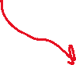

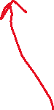
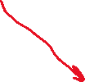
Frontend
WebFlux
Warehouse service
Desk Service
Exchange Service
WebFlux
WebClient
WebClient
WebFlux
Data Reactive
Data Reactive
Data Reactive
Notes:
Overall, we are also using reactive mongo framework, so we don’t have blocking code in the architecture. It is now responsive.

Slide 10
Interface spaghetti
Responsive
Elastic
Resilient
Message Driven
Notes:
Offs…, As more services keep evolving or new services created, we now have to manage those many API/interfaces. Which is another hassle.
---
Now with this architecture we have got the characteristic like responsive, elastic(using docker/Kubernetes).
---
If we talk about distributed system, it is not really using message. Even though the code is reactive but from system level view it is not really distributed. It is non blocking code, for it to be distributed, I need it to have some message that is consumed by my new API.
Reactive Systems rely on asynchronous message-passing to establish a boundary between components that ensures loose coupling, isolation and location transparency. This boundary also provides the means to delegate failures as messages. Employing explicit message-passing enables load management, elasticity, and flow control by shaping and monitoring the message queues in the system and applying back-pressure when necessary
---
No resilient, if one service fails while processing the request will loose that request to service.
---
I need to think about how to implement my business logic around them. If we think micro service is the common way to handle this , then it is a saga pattern. Which take care of my business logic and it is responsible for it.

Slide 11
Saga Pattern
It prevent us from doing distributed transaction
It uses local transaction and also make sure that saga is completed
If something goes wrong, it make sure to roll back.
Implementing saga pattern with reactive coding is just not possible
We need to think about messaging in a distributed system
Common way to do it by introducing a message broker
Loose coupling with messages
Notes:
Currently this architecture has no way to ensure data consistency for the process. Since saga pattern helps with data consistency it requires a way to trigger event/message as a mean to notify other service so completion of its processing and it made some local transaction so other other on listening to those events can do their intended job and triggers another event for other service.

Slide 12
Saga Pattern
Implement each business transaction that spans multiple services is a saga. A saga is a sequence of local transactions.
Each local transaction updates the database and publishes a message or event to trigger the next local transaction in the saga.
If a local transaction fails because it violates a business rule, then the saga executes a series of compensating transactions that undo the changes that were made by the preceding local transactions.
Implementing saga pattern with reactive coding is just not possible
Notes:
Currently this architecture has no way to ensure data consistency for the process. Since saga pattern helps with data consistency it requires a way to trigger event/message as a mean to notify other service so completion of its processing and it made some local transaction so other other on listening to those events can do their intended job and triggers another event for other service.
We need to think about messaging in a distributed system
Common way to do it by introducing a message broker
Loose coupling with messages

Slide 13
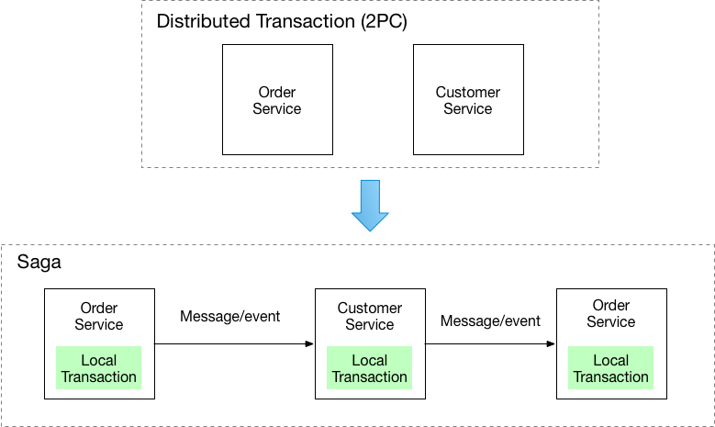
Image source: https://microservices.io/

Slide 14





Message Driven
fun sendShippingOrder(orderId:String){
kafkaTemplate.send(“shippingOrdered”, orderId)
}
@kafkaListener(topics=“shippingOrdered”)
fun prepareShippings(orderId:String) {
Println(“Your shippings is ready”)
shippingConfirmProducer.sendConfirmation(orderId)
}
Desk Service
Shipping Order Confirmed
Message Broker
Place Shipping Order
Warehouse service
Notes:
Introducing message broker in the architecture, could look like this. Desk Service sends the message about the order to the kafka broker. Here Desk Service doesn’t need to know about the warehouse service. It only cares about how the message payload looks like for the order.

Slide 15
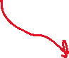

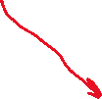
Frontend
WebFlux
Warehouse service
Desk Service
Exchange Service
Message
Message
Message
Data Reactive
Data Reactive
Data Reactive
Message Broker
Notes:
After exchanging the points which allow to end in the application and replacing with message broker looks like this.
Here desk service has my business logic.

Slide 16
Awesome we achieved all four!!
Responsive
Elastic
Resilient
Message Driven
Notes:
We are responsive.
We are elastic, as we can scale and deploy using Kubernetes and docker which makes this easy.
We are resilient, if one system fail, we are able to recover from it and continue the job.
We are message driven.
This looks good but there is still something we are missing

Slide 17
complaint service
Login service
Frontend
Helpdesk Service
Audit Service
Compliance Service
Warehouse service
Desk Service
Exchange Service
EMI service
BNPL Service
Offer service
Discount Service
Payment service
Accounting Service
cart service
Tracking Service
Notes:
In reality there won’t be 2-3 services that will be running to support the business. We can easily think about other common services and now it is grow like a big giant and it will keep going as business expand and grows. Now I have lot of messages going around in the system and it is really complex situation to debug the issue if customer didn’t received his shipment on time. He can go to Twitter and tweet and bad mouth company and bunch of other stuffs like ruckus in office.
If customer ask about where is his shipment. I don’t know, system seems fine there is no issue reported. Something might have went wrong with the payload and I don’t know how to debug your issue now?
It is hard to understand the logic and flow of the system. I have no visibility which message is been sent and all.

Slide 18
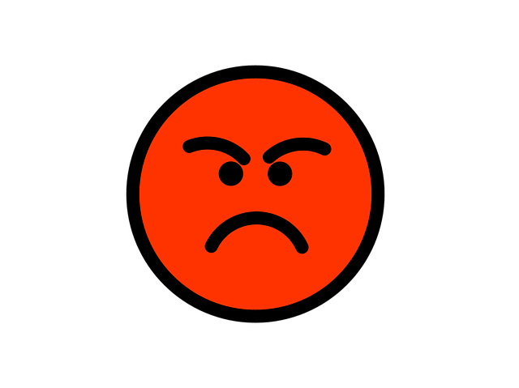
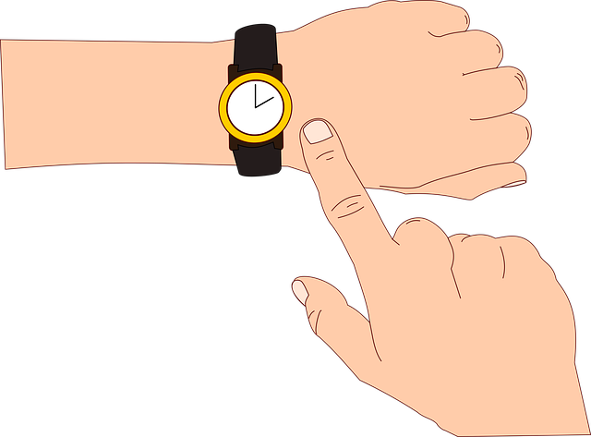

I haven’t received my order yet, Where is it?

Slide 19

How to bring order in chaos?
Detect the problem quickly
Observability
Understanding what is going on
Notes:
What can we do to the current architecture so that it enables quick problem detection?
Observability is just complements but that it not the primary approach to detect problem quickly/immediately

Slide 20

State in a reactive system
Notes:
We can change current architecture by adding state to our created reactive system. There are multiple way to achieve that. Know we now that Saga pattern is the answer there is 2 ways to achieve that. Choreography and Orchestrator are the 2 ways to implement that..

Slide 21
Different ways for saga coordination?

Slide 22
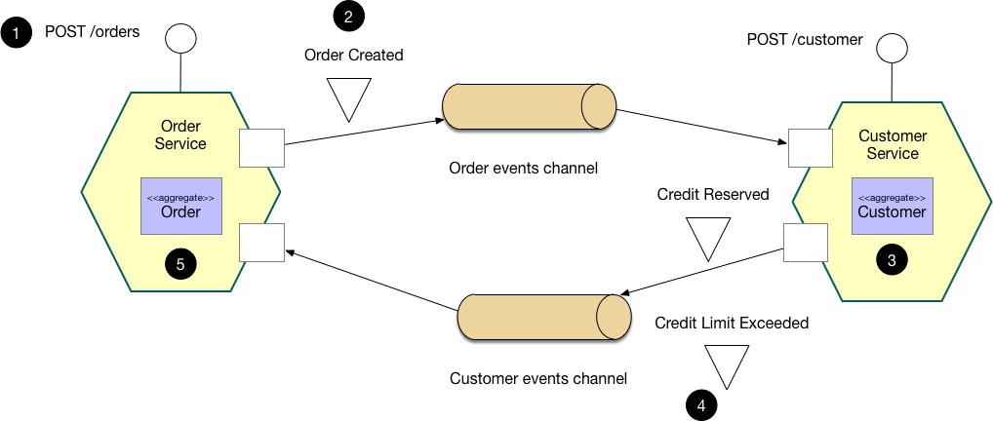
Choreography-based saga
Image source: https://microservices.io/
Notes:
This pattern has the following benefits:
It enables an application to maintain data consistency across multiple services without using distributed transactions
This solution has the following drawbacks:
The programming model is more complex. For example, a developer must design compensating transactions that explicitly undo changes made earlier in a saga.

Slide 23

Solution: Define saga(process) in an orchestrated way

Slide 24

Workflow Engines
Service A
Service B
Service C
Notes:
In this slide you see a basic flow which calls 3 services for completion. Here work flow knows what things it need to do and what are the dependencies for the next step.
Workflow engine define a saga and can be a orchestrator in a microservice in a architecture. Instead of going from event driven, we can go with orchestrate things.
We start the saga (process) and once we arrive at service A, there Service A does its action and then go to service B and later Service C.
There are multiple workflow engine available like Netflix has conductor

Slide 25
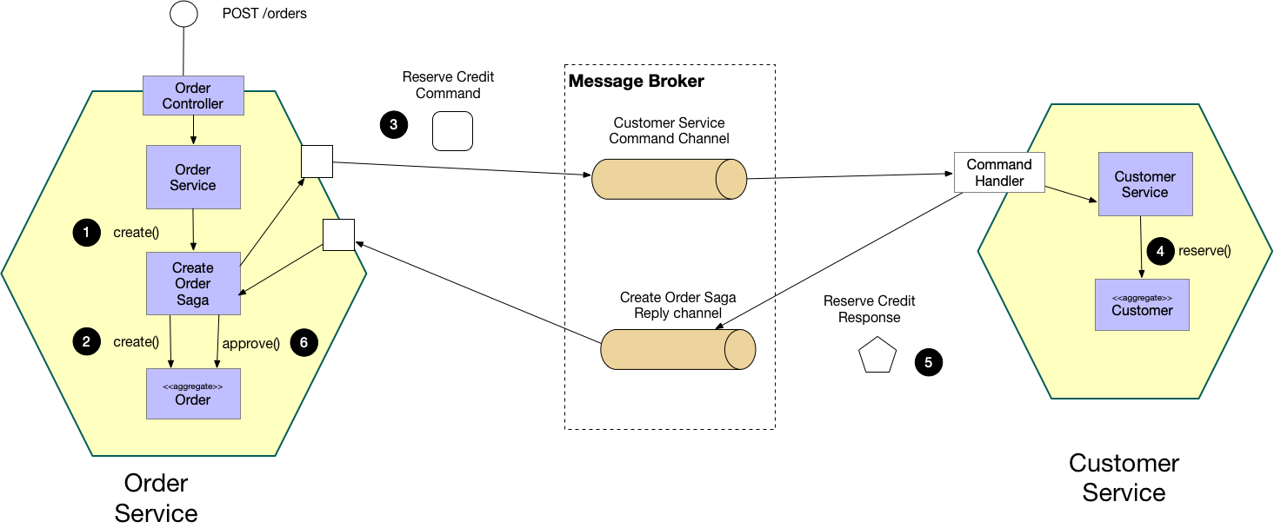


Orchestration-based saga
Image source: https://microservices.io/
Notes:
This pattern has the following benefits:
It enables an application to maintain data consistency across multiple services without using distributed transactions
This solution has the following drawbacks:
The programming model is more complex. For example, a developer must design compensating transactions that explicitly undo changes made earlier in a saga.

Slide 26
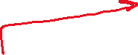
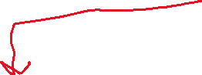
Workflow Engine
API Request
Desk Service
Message Broker
Notes:
There will be some code in the service which knows that is been done till now and what next it has to do. Desk service has business logic for the application, and it act as orchestrator as it knows what next to do and what the current state of the application/request.
Now if something goes wrong, we can check the process and come to know that process is waiting for this service and accordingly we can make the right decision to resolve the problem.

Slide 27
Desk Service
enterShop
.next(orderProduct)
.next(placeOrder)
.next(makePayment, dependsOn= placeOrder)
.next(checkPaymentStatus)
.next(createInvoice, dependsOn = checkPaymentStatus)
.next(sendCommunication)
val placeOrder = decisionBranch(WITH_EXCHANGE= flow1, WITHOUT_EXCHANGE= flow2)
val flow1 = parallel(placeShippingOrder, placeExchangeOrder)
val flow2 = placeShippingOrder

Slide 28









POST /start-journey
Place Orders
orderProduct
OrderPlaced,
nextStep: waitForConfirmation
placeOrderDecision
placeShippingOrder
placeShippingOrder
Make Payment
placeExchangeOrder
PaymentCompleted,
nextStep: Completed
makePayment
createInvoice
Notify Customer
sendCommunication
completed
Desk Service

Slide 29


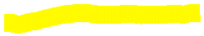

//desk service
class PlaceOrder(
withExchange: Step,
withoutExchange: Step
) : DecisionStep() {
override fun execute(orders: Orders) : Step {
return if(orders.withExchange){ withExchange
} else { withoutExchange }
}
}
//desk service
class PlaceShippingOrder(
val producer: ShippingOrderProducer
) : SystemStep() {
override fun execute(orders: Orders) {
doSomething(orders)
producer.send(orders.identifier)
}
}
//warehouse service
@kafkaListener(topics=“shippingOrdered”)
fun prepareShippings(orderId:String) {
Println(“Your shippings is ready”)
shippingConfirmProducer.sendConfirmation(orderId)
}
Message Broker

Slide 30

Any tool/ framework that is available, which does this things?
Notes:
Now we saw that what ever we discussed for saga pattern is complex to implement and it is not easy to cover varies usecase so is there any production ready tool/framework available which allows data consistency but for distributed application?

Slide 31
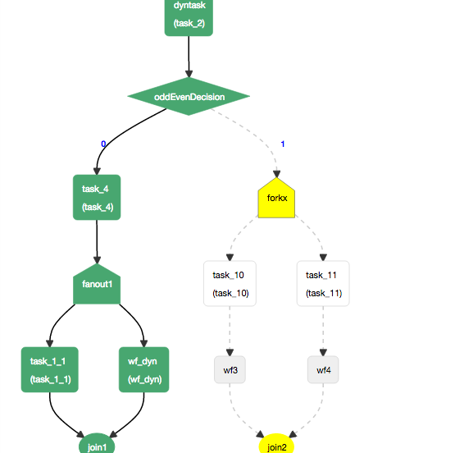
Netflix Conductor Workflow example

Slide 32
Conductor sample example
Task definition:
https://github.com/orkes-io/orkesworkers/blob/main/data/task/image_convert_resize.json
Workflow definition:
https://github.com/orkes-io/orkesworkers/blob/main/data/workflow/image_convert_resize.json
Worker implementation:
https://github.com/orkes-io/orkesworkers/blob/main/src/main/java/io/orkes/samples/workers/ImageConvertResizeWorker.java

Slide 33
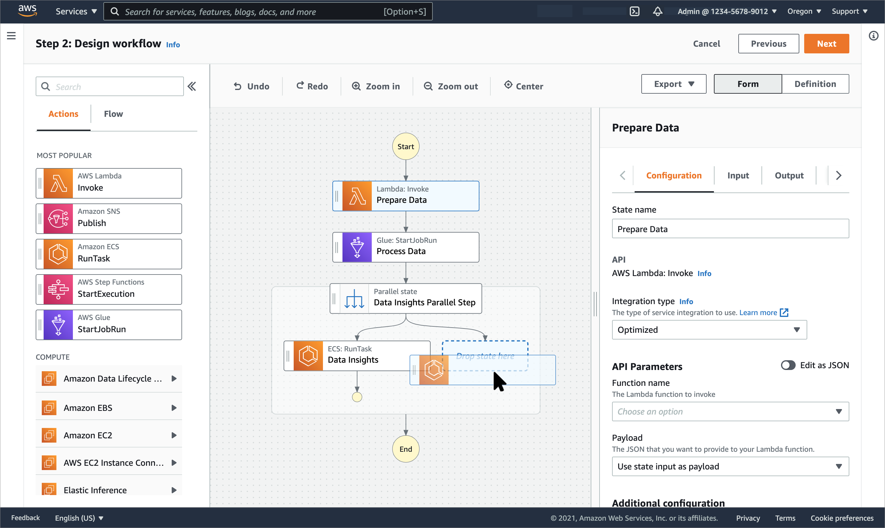

Slide 34
Let’s see another example. (bit complex)
Notes:
We are using similar thing in our project. We saw lot of theory let’s see some code and understand how it is done in forex project.

Slide 35
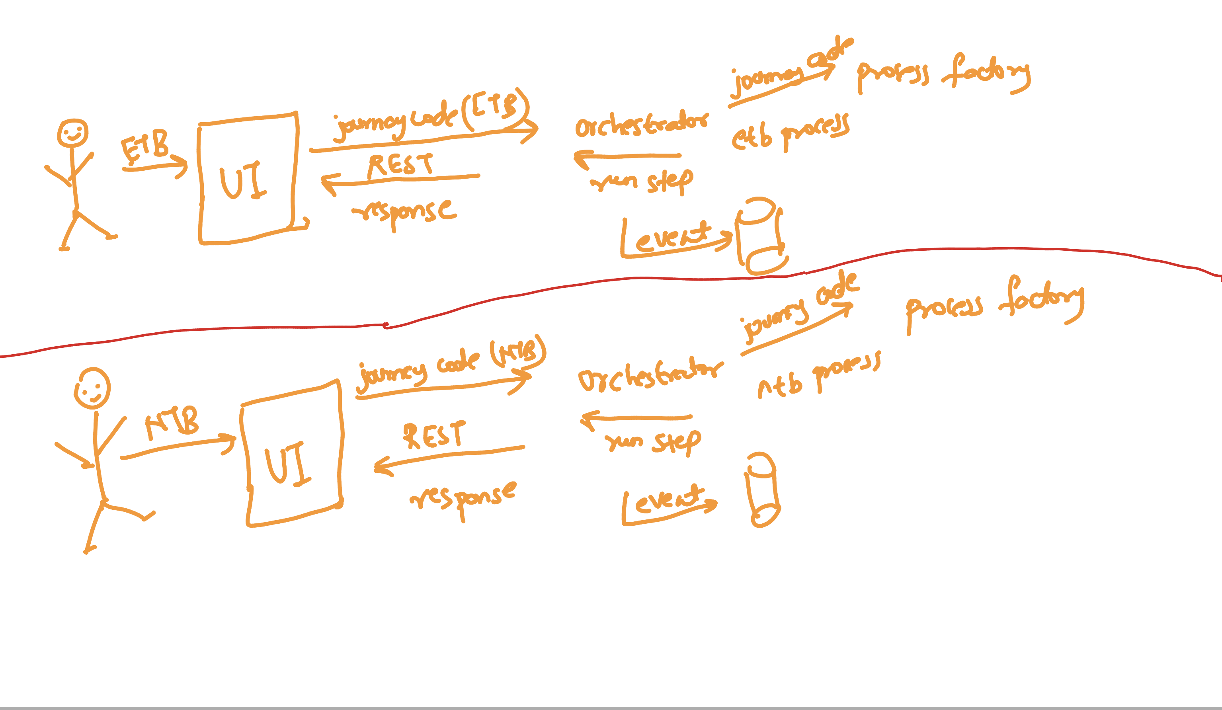
Notes:
Code example : Open IDE and show the code walk through

Slide 36
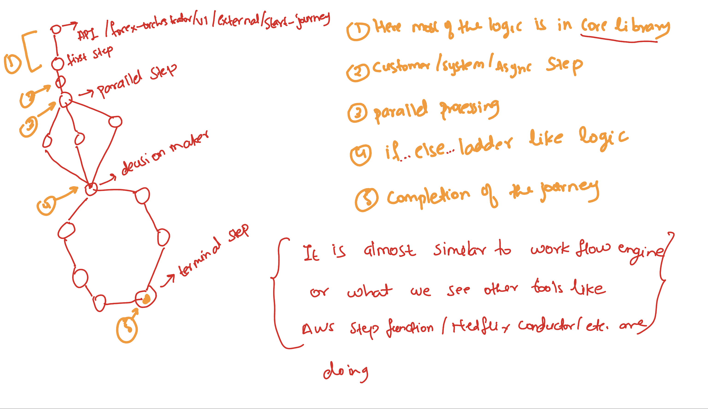
Notes:
Where it is configured? Open IDE and show them

Slide 37
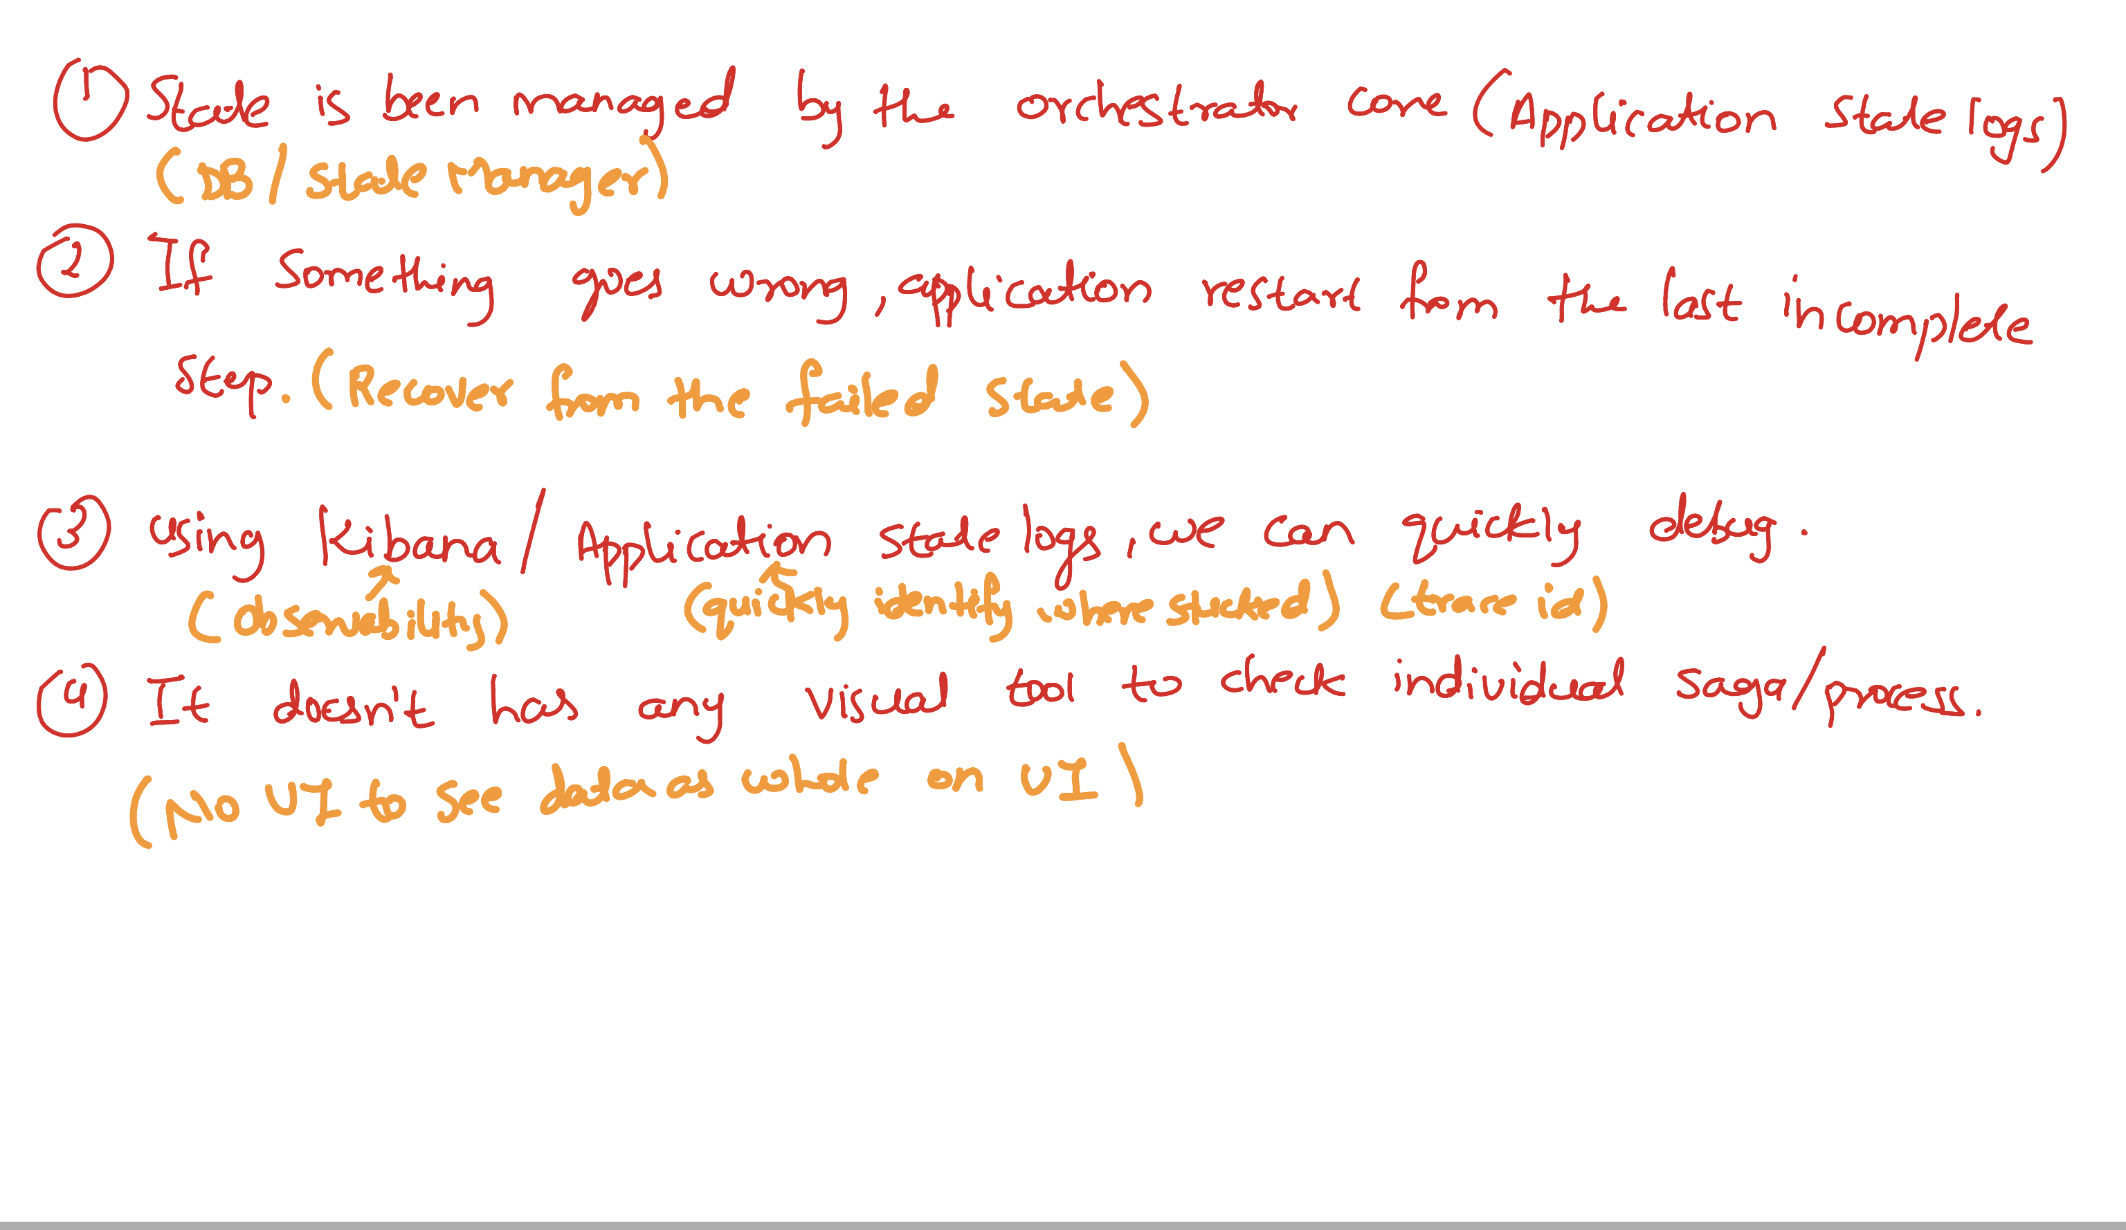

Slide 38
State
In Forex, we are using orchestrator coordinated saga pattern (orchestrator core and orchestrator). In reality , It creates a saga(process) whenever new request is been sent to it from frontend.
Orchestrator is responsible for containing the business logic and also state of each request. Other services doesn’t know whether any state is been managed.
If you re-login again, saga checks the state and based on the decided what to do next.
If any thing goes wrong, we can check the state logs and realize where it is stuck and based on that debug the issue.

Slide 39
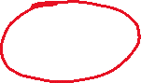
Thank you

Slide 40
Reference
Spring I/O 2022: Be proactive about state in a reactive system by Nele Lea Uhlemann (https://www.youtube.com/watch?v=KUsPQGi3dFg&ab_channel=SpringI%2FO)
Saga Pattern: https://microservices.io/patterns/data/saga.html
Next,
Read Book: Practical Process Automation: Orchestration and Integration in Microservices and Cloud Native Architectures by Bernd Ruecker (Author)

